Slide 1

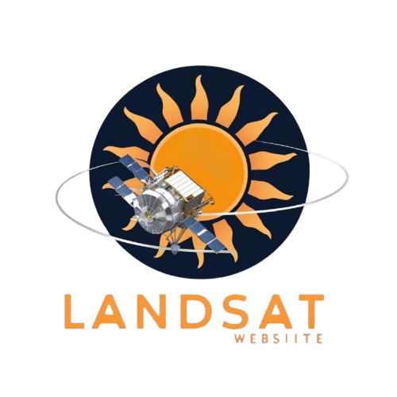



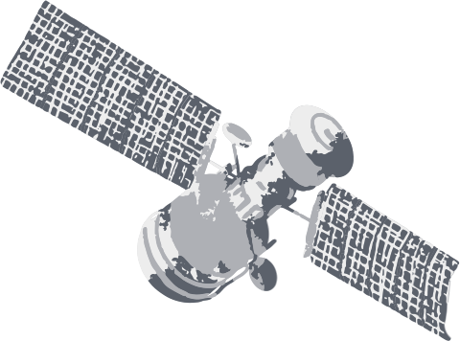

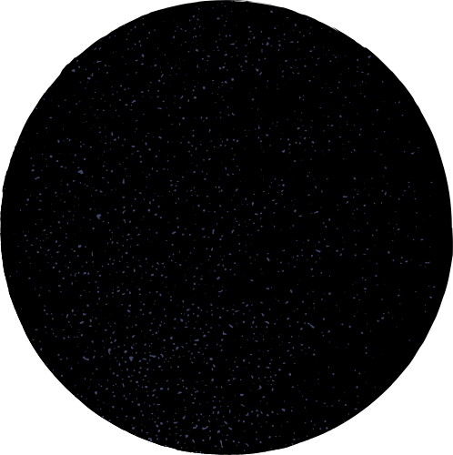
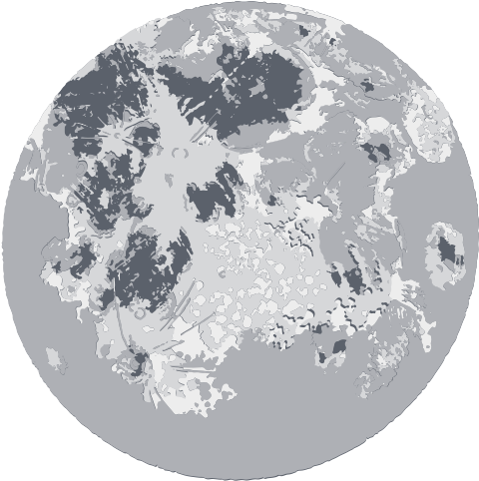

LANDSAT REFLECTANCE DATA:
ON THE FLY AND AT YOUR FINGERTIPS

Slide 2



HELLO SPACE EXPLORERS !
Introduction
The NASA Space Apps Challenge 2024 invites the development of an innovative web application that enables the comparison of ground observations with Landsat surface reflectance (SR) data.
This tool not only has the potential to enrich education and scientific exploration, but also empowers users to become informed and active global citizens in environmental monitoring.
The integration of Landsat data, real-time notifications, and data visualization in a single platform facilitates an interdisciplinary approach that promotes experiential learning.

Slide 3
1.nitial Research: Review of Landsat documentation and existing geospatial data applications to identify key features and best practices.
2. Application Design: User Interface:
Create an intuitive interface that allows users to define a target location via coordinates, place name, or map selection.
Notification System: Implement a system that notifies users about upcoming Landsat passes over the defined location, with customization options.
3. Data Access: Integrate APIs and data catalogs to enable acquisition of Landsat SR data and related metadata, as well as cloud cover calculations.
4. Data Visualization: Develop interactive graphs representing reflectance data across the spectrum, along with a pixel grid and scene metadata.
5. Testing and Validation: Conduct pilot tests with real users to gather feedback and adjust the application as needed.
Methodology
To address the challenge, a multistage methodology is proposed

Slide 4



REQUIREMENTS
The web application should enable users to interact with satellite data, such as Landsat, and ground-based observations. Users will be able to refine time series by selecting a range of years or specifying exact dates through a date modal. Additionally, the application will allow users to select locations via map clicks, enter place names, or input geographic coordinates. The system will update the map with the selected position and display the satellite’s overpass date along with relevant metadata. This metadata can be downloaded in various formats, including Excel, CSV, Parquet, or JSON. Additional features include grid visualization, data filtering based on cloud coverage, the presentation of temperature data, and the generation of satellite trajectories for a specific location.

Slide 5




CHALLENGE GOALS
Ionosfera
The challenge aims to promote local and global impact through a web application that enhances education, collaboration, and storytelling using satellite data. It fosters community learning about remote sensing with interactive tutorials and real-time data access, encouraging citizen science and environmental monitoring. Globally, it supports multilingual interfaces and collaboration between scientists, researchers, and citizens. The application allows for the creation of visual stories to inspire conservation efforts, while also contributing to NASA’s mission by integrating scientific knowledge and training opportunities. Furthermore, it emphasizes open data access, mobile optimization, real-time interaction, and aesthetically designed visualizations that blend art with science. Finally, it encourages the rigorous use of scientific methods and data analysis tools, facilitating transparency and collaboration in research and data science.
Exosfera
Termosfera
Mesosfera
Estratosfera
Troposfera

Slide 6

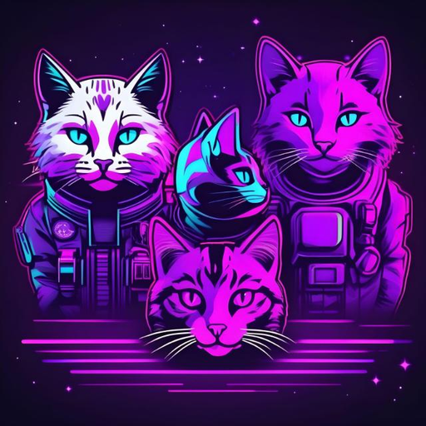
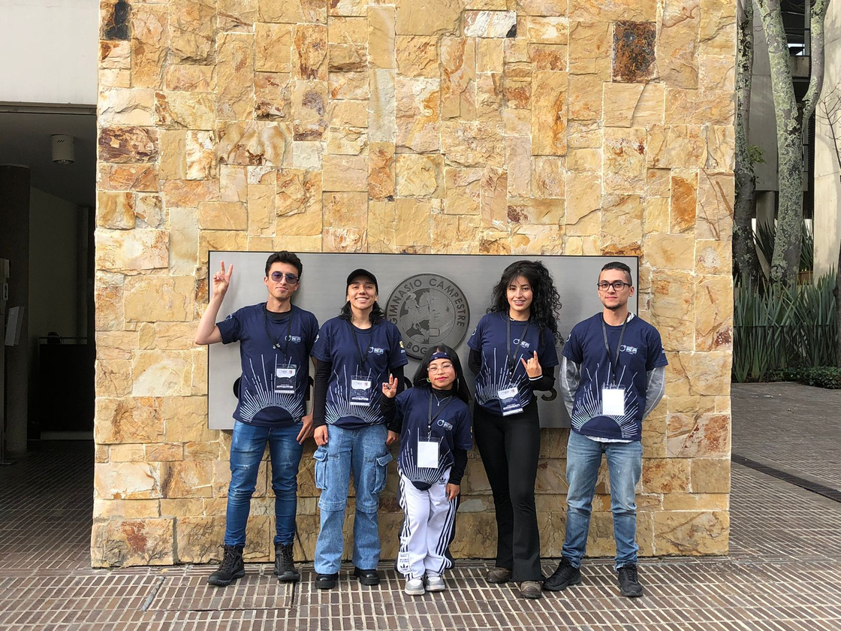


TEKNOCRAFTERS

Slide 7
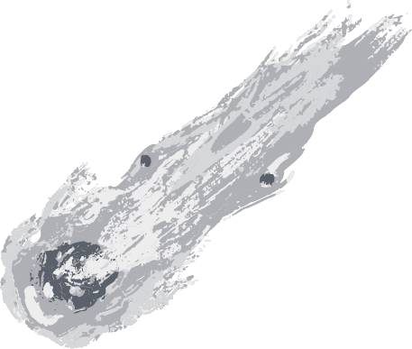



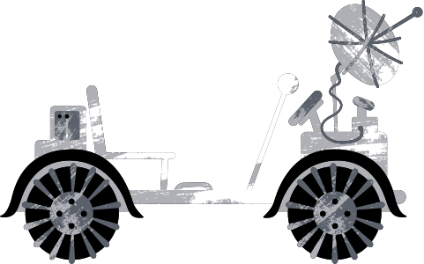
¡MISSION ACCOMPLISHED!
see you next time

